Slide 1

Session 2
Java Language Fundamentals

Slide 2
Review
Java was introduced by Sun Microsystems in 1995.
Java is a programming language popularly used to build programs that can work on the Net.
Its primary features are: it is object-oriented and a cross platform language.
Swing, Drag and Drop, Java 2D API, Java Sound and RMI are some of the features added to the existing version of Java.
A Java applet is designed to work in a pre-defined “sandbox” only. This makes it safe to be used on the Internet.
Java bytecodes are machine language instructions understood by the Java Virtual Machine and usually generated as a result of compiling Java language source code.

Slide 3
Review Contd…
Java programs can be divided into following categories-applets, applications, GUI applications, servlets and database applications.
Java visual development tools help the programmer to develop Java applications and applets more quickly and efficiently.
The JDK contains the software and tools needed to compile, debug and execute applets and applications written in the Java language. It’s basically a set of command-line tools.
Enhancement in Swing, AWT, a new I/O class and so on has been added in the latest version of Java 1.4.2.
The future will use a lot of Java related programs for consumer gadgets with embedded technologies.

Slide 4
Objectives
Interpret the Java Program
Understand the basics of Java Language
Identify the Data Types
Understand arrays
Identify the Operators
Format output using Escape Sequence

Slide 5
A Sample Java program
// This is a simple program called First.java
class First
{
public static void main (String [] args)
{
System.out.println ("My first program in Java ");
}
}

Slide 6
Analyzing the Java Program
The symbol // stands for commented line.
The line class First declares a new class called First.
public static void main (String [] args)
  This is the main method from where the program begins its execution.
System.out.println (“My first program in java”);
  This line displays the string My first program in java on the screen.

Slide 7
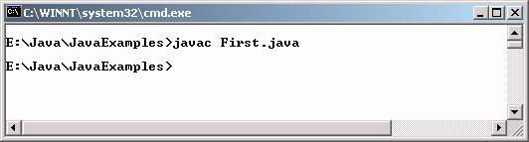
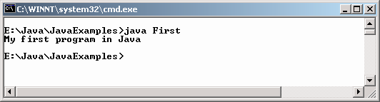
Compiling and executing the Java program
The java compiler creates a file called 'First.class' that contains the byte codes
To actually run the program, a java interpreter called java is required to execute the code.

Slide 8
Passing Command Line Arguments
class CommLineArg
{
public static void main (String [] pargs)
{
System.out.println("These are the arguments passed to the main method.");
System.out.println(pargs [0]);
System.out.println(pargs [1]);
System.out.println(pargs [2]);
}
}

Slide 9
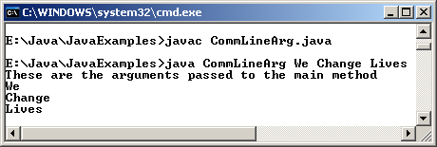
Passing Command Line Arguments
Output

Slide 10
Basics of the Java Language
Classes & Methods
Data types
Variables
Operators
Control structures

Slide 11
Classes in Java
Class declaration Syntax
class Classname
{
var_datatype variablename;
:
met_datatype methodname(parameter_list)
:
}

Slide 12
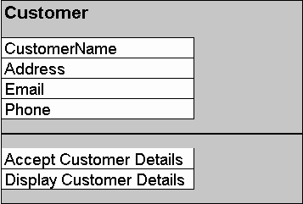

Sample class

Slide 13
Data Types
Primitive Data Types
Reference data types
byte
char
boolean
short
int
long
float
double
Array
Class
Interface

Slide 14
Type Casting
In type casting, a data type is converted into another data type.
Example
    float c = 34.89675f;
    int b = (int)c + 10;

Slide 15
Automatic type and Casting
There are two type of data conversion: automatic type conversion and casting.
When one type of data is assigned to a variable of another type then automatic type conversion takes place provided it meets the conditions specified:
  The two types are compatible
  The destination type is larger than the source type.
Casting is used for explicit type conversion. It loses information above the magnitude of the value being converted.

Slide 16
Type Promotion Rules
All byte and short values are promoted to int type.
If one operand is long, the whole expression is promoted to long.
If one operand is float then the whole expression is promoted to float.
If one operand is double then the whole expression is promoted to double.

Slide 17
Variables
Three components of a variable declaration are:
  Data type
  Name
  Initial value to be assigned (optional)
Syntax
  datatype identifier [=value][, identifier[=value]...];

Slide 18
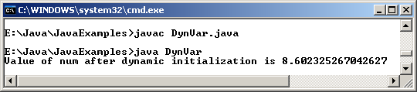
Example
class DynVar
{
public static void main(String [] args)
{
double len = 5.0, wide = 7.0;
double num = Math.sqrt(len * len + wide * wide);
System.out.println("Value of num after dynamic initialization is " + num);
}
}
Output

Slide 19
Scope and Lifetime of Variables
Variables can be declared inside a block.
The block begins with an opening curly brace and ends with a closing curly brace.
A block defines a scope.
A new scope is created every time a new block is created.
Scope specifies what objects are visible to other parts of the program.
It also determines the life of an object.

Slide 20
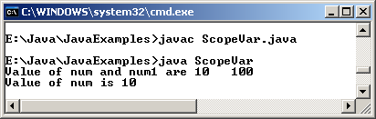
Example
class ScopeVar
{
public static void main(String [] args)
{
int num = 10;
if ( num == 10)
{
// num is available in inner scope
int num1 = num * num;
System.out.println("Value of num and num1 are " + num + " " + num1);
}
//num1 = 10; ERROR ! num1 is not known
System.out.println("Value of num is " + num);
}
}
Output

Slide 21
Array Declarations
Three ways to declare an array are:
  datatype identifier [ ];
  datatype identifier [ ] = new datatype[size];
  datatype identifier [ ] = {value1,value2,….valueN};

Slide 22
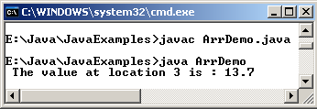
Example – One Dimensional Array
class ArrDemo
{
public static void main(String [] arg)
{
double nums[] = {10.1, 11.3, 12.5,13.7, 14.9};
System.out.println(" The value at location 3 is : " + nums[3]);
}
}
Output

Slide 23
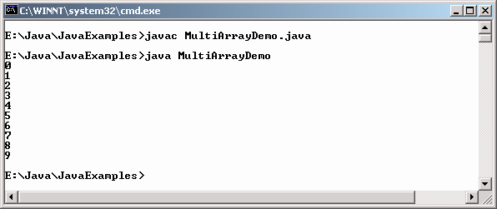
Example – Multi Dimensional Array
class MultiArrayDemo
{
public static void main ( String [] arg)
{
int multi[][] = new int [4][];
multi[0] = new int[1];
multi[1] = new int[2];
multi[2] = new int[3];
multi[3] = new int[4];
int num = 0;
for (int count = 0; count < 4; count++)
{
for (int ctr = 0; ctr < count+1; ctr++)
{
multi[count][ctr] = num;
num++;
}
}
for (int count = 0; count < 4; count++)
{
for (int ctr = 0; ctr < count+1; ctr++)
{
System.out.print(multi[count][ctr] + " ");
System.out.println();
}
}
}
}
Output

Slide 24
Operators
Arithmetic Operators
Bitwise Operators
Relational Operators
Logical Operators
Conditional Operators
Assignment operators

Slide 25
Arithmetic Operators
Operands of the arithmetic operators must be of numeric type.
Boolean operands cannot be used, but character operands are allowed.
These operators are used in mathematical expressions.

Slide 26
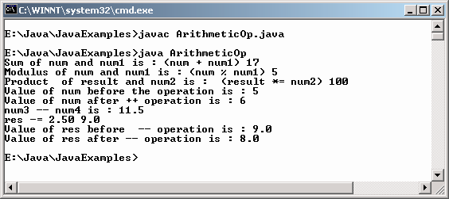
Example
class ArithmeticOp
{
public static void main ( String [] arg)
{
int num = 5, num1 = 12, num2 = 20, result;
result = num + num1;
System.out.println("Sum of num and num1 is : (num + num1) " + result);
result = num % num1;
System.out.println("Modulus of num and num1 is : (num % num1) " + result);
result *= num2;
System.out.println("Product of result and num2 is : (result *= num2) " + result);
System.out.println("Value of num before the operation is : " + num);
num ++;
System.out.println("Value of num after ++ operation is : " + num);
double num3 = 25.75, num4 = 14.25, res;
res = num3 - num4;
System.out.println("num3 – num4 is : " +res);
res -= 2.50;
System.out.println("res -= 2.50 " + res);
System.out.println("Value of res before -- operation is : "+ res);
res--;
System.out.println("Value of res after -- operation is : " + res);
}
}
Output

Slide 27
Bitwise Operators
A bitwise operator allows manipulation of individual bits in an integral primitive data type.
These operators act upon the individual bits of their operands.
Bitwise operators perform Boolean algebra on the corresponding bits in the two arguments to produce the result.

Slide 28
Relational Operators
Relational operators test the relation between two operands.
The result of an expression in which relational operators are used, is boolean (either true or false).
Relational operators are used in control structures.

Slide 29
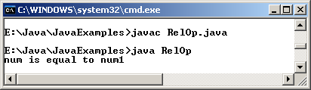
Example
class RelOp
{
public static void main(String [] args)
{
float num = 10.0F;
double num1 = 10.0;
if (num == num1)
System.out.println ("num is equal to num1");
else
System.out.println ("num is not equal to num1");
}
}
Output

Slide 30
Logical Operators
Logical operators work with boolean operands.
Some operators are
  &
  |
  ^
  !

Slide 31
Conditional Operators
The conditional operator is unique, because it is a ternary or triadic operator that has three operands to the expression.
It can replace certain types of if-then-else statements.
The code below checks whether a commuter’s age is greater than 65 and print the message.
CommuterCategory = (CommuterAge > 65)? “Senior Citizen” : “Regular”;

Slide 32
Assignment Operators
The assignment operator is a single equal sign, =, and assigns a value to a variable.
Assigning values to more than one variable can be done at a time.
In other words, it allows us to create a chain of assignments.

Slide 33
Operator Precedence
Parentheses: ( ) and [ ]
Unary Operators: +, -, ++, --, ~, !
Arithmetic and Shift operators: *, /, %, +, -, >>, <<
Relational Operators: >, >=, <, <=, ==, !=
Logical and Bitwise Operators: &, ^, |, &&, ||,
Conditional and Assignment Operators: ?=, =, *=, /=, +=, -=
Parentheses are used to change the order in which an expression is evaluated. Any part of an expression enclosed in parentheses is evaluated first.

Slide 34
Formatting output with Escape Sequences
Whenever an output is to be displayed on the screen, it needs to be formatted.
The formatting can be done with the help of escape sequences that Java provides.
System.out.println (“Happy \tBirthday”);
  Output: Happy Birthday

Slide 35
Control Flow
All application development environments provide a decision making process called control flow statements that direct the application execution.
Flow control enables a developer to create an application that can examine the existing conditions, and decide a suitable course of action.
Loops or iteration are an important programming construct that can be used to repeatedly execute a set of actions.
Jump statements allow the program to execute in a non-linear fashion.

Slide 36
Control Flow Structures in Java
Decision-making
  if-else statement
  switch-case statement
Loops
  while loop
  do-while loop
  for loop

Slide 37
if-else statement
The if-else statement tests the result of a condition, and performs appropriate actions based on the result.
It can be used to route program execution through two different paths.
The format of an if-else statement is very simple and is given below:
if (condition)
{
action1;
}
else
{
action2;
}

Slide 38
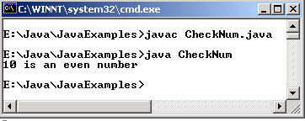
Example
class CheckNum
{
public static void main(String [] args)
{
int num = 10;
if (num % 2 == 0)
System.out.println(num + " is an even number");
else
System.out.println(num + " is an odd number");
}
}
Output

Slide 39
switch – case statement
The switch – case statement can be used in place of if-else-if statement.
It is used in situations where the expression being evaluated results in multiple values.
The use of the switch-case statement leads to simpler code, and better performance.

Slide 40
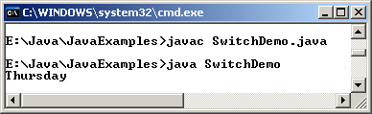
Example
class SwitchDemo
{
public static void main(String[] args)
{
int day = 4;
String str;
switch (day)
{
case 0:
str = "Sunday";
break;
case 1:
str = "Monday";
break;
case 2:
str = "Tuesday";
break;
case 3:
str = "Wednesday";
break;
case 4:
str = "Thursday";
break;
case 5:
str = "Friday";
break;
case 6:
str = "Saturday";
break;
default:
str = "Invalid day";
}
System.out.println(str);
}
}
Output

Slide 41
while Loop
while loops are used for situations when a loop has to be executed as long as certain condition is True.
The number of times a loop is to be executed is not pre-determined, but depends on the condition.
The syntax is:
    while (condition)
    {
    action statements;
    .
    .
    .}

Slide 42
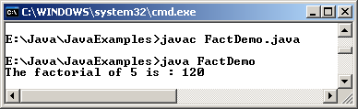
Example
class FactDemo
{
public static void main(String [] args)
{
int num = 5, fact = 1;
while (num >= 1)
{
fact *= num;
num--;
}
System.out.println("The factorial of 5 is : " + fact);
}
}
Output

Slide 43
do – while Loop
The do-while loop executes certain statements till the specified condition is True.
These loops are similar to the while loops, except that a do-while loop executes at least once, even if the specified condition is False. The syntax is:
    do
    {
    action statements;
    .
    .
    } while (condition);

Slide 44
Example
class DoWhileDemo
{
public static void main(String [] args)
{
int count = 1, sum = 0;
do
{
sum += count;
count++;
}while (count <= 100);
System.out.println("The sum of first 100 numbers is : " + sum);
}
}
Output
The sum of first 100 numbers is : 5050

Slide 45
for Loop
All loops have some common features: a counter variable that is initialized before the loop begins, a condition that tests the counter variable and a statement that modifies the value of the counter variable.
The for loop provides a compact format for incorporating these features.
Syntax:
  for (initialization statements; condition; increment / decrement statements)
  {
  action statements;
  .
  .
  }

Slide 46
Example
class ForDemo
{
public static void main(String [] args)
{
int count = 1, sum = 0;
for (count = 1; count <= 10; count += 2)
{
sum += count;
}
System.out.println("The sum of first 5 odd numbers is : " + sum);
}
}
Output
The sum of first 5 odd numbers is : 25

Slide 47
Jump Statements
Three jump statements are:
  break
  continue
  return
The three uses of break statements are:
  It terminates a statement sequence in a switch statement.
  It can be used to exit a loop.
  It is another form of goto.

Slide 48
Example
class BrDemoAppl
{
public static void main(String [] args)
{
for (int count = 1; count <= 100; count++)
{
if (count == 10)
break;
System.out.println("The value of num is : " + count);
}
System.out.println("The loop is over");
}
}
Output
The value of num is : 1
The value of num is : 2
The value of num is : 3
The value of num is : 4
The value of num is : 5
The value of num is : 6
The value of num is : 7
The value of num is : 8
The value of num is : 9
The loop is over

Slide 49
Summary
A Java program consists of a set of classes. A program may contain comments. The compiler ignores this commented lines.
The Java program must have a main() method from where it begins its execution.
Classes define a template for units that store data and code related to an entity.
Variables defined in a class are called the instance variables.
There are two types of casting:widening and narrowing casting.
Variables are basic unit of storage.
Each variable has a scope and lifetime.
Arrays are used to store several items of same data type in consecutive memory locations.

Slide 50
Summary Contd…
Java provides different types of operators. They include:
  Arithmetic
  Bitwise
  Relational
  Logical
  Conditional
  Assignment
Java supports the following programming constructs:
  if-else
  switch
  for
  while
  do-while
The three jump statements-break,continue and return helps to transfer control to another part of the program.

